Slide 1
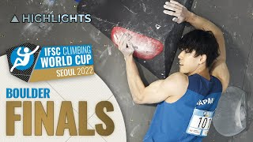
Notes:
Gilaine

Slide 2
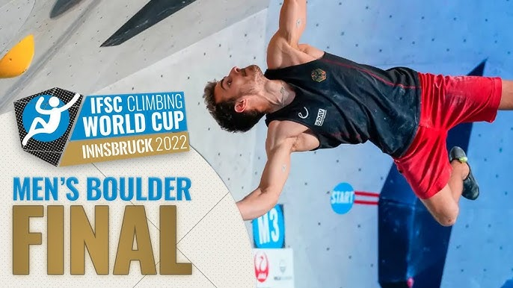
Bouldering Competition
Group 2
David Chartrand, Gilaine Soares, Aditi Bindlish, Chu Nguyen Kien
Notes:
Gilaine

Slide 3
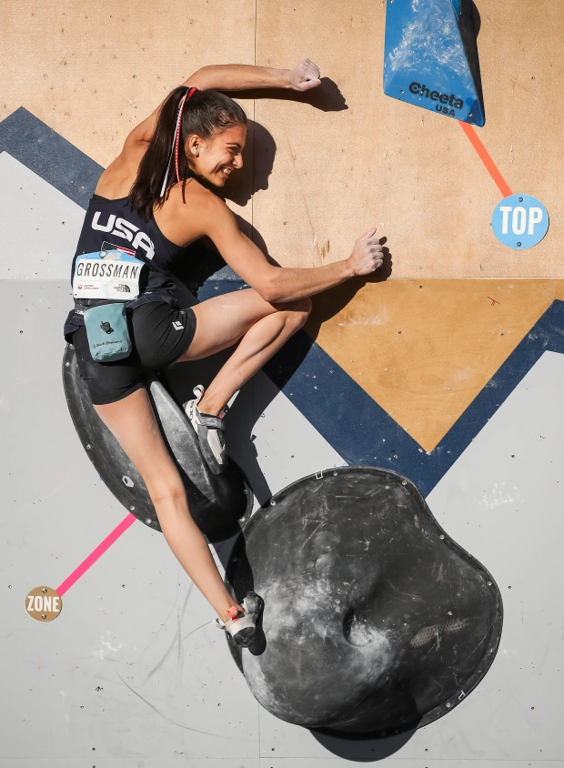
What is Bouldering?
Notes:
David Chartrand
What is bouldering?
Bouldering is a sport where competitors must climb many small but challenging routes, called “boulder problems”, with the fewest attempts in a given time.
These so called problems challenge athletes mentally and physically as they use their strength and wits to ascend the wall.This sport is done without ropes.
Each boulder problem has a designated starting position.The zone hold is approximate at the halfway point. The highest hold is considered the “top” of the boulder.
At the end of the round, climbers are ranked based on most boulders topped, most zone holds reached, and fewest total attempts.
These competition are separated into qualifications, semifinals, and finals.

Slide 4
Questions we want to answer
Why did we select this topic?
1. Can we accurately predict the winner of the next competition for players based off their previous scores ?
2.What is the best Machine Learning model for this purpose?
A large dataset available to work with
Possibility to offer the companies a source of advertisement.
Notes:
Gilaine

Slide 5
Project Overview – Group 2
ETL | Cleaning the data (duplicates, null values, remove HTML tags, special characters, convert everything to lowercase, etc.)
Download the data set | Import libraries
Creating the model
Output & Train test split
Prediction and accuracy metrics to choose the best model
Statistical Analysis & Data Analysis findings
Notes:
Gilaine

Slide 6

ETL Process
Extract (Kaggle CSV)
Transform
Load
Competition Title, Competition Date, FIRST, LAST, Nation, StartNr, Rank, Qualification, Qualification 1, Qualification 2, Semifinal, Final, Category
64 Nations
1101 Climbers
19 Competitions
Extracted scores from qualifiers, semi-finals, and finals each into 4 separate classifications of Tops, Zones, Tops Attempt, and Zones Attempt.
Uploaded new csv into a table in SQLite.
Notes:
Chu - “The International Federation of Sport Climbing (IFSC) provides official data of climbers and competitions. We have extracted our dataset from kaggle and it provides web scraped data containing these columns. Some notable values were the 64 unique nations, 1101 climbers, and 19 competitions. Once we read the raw data, first we dropped any NAs then we needed to separate the scoring system in the qualification into their own columns. We did this by looping through the qualifiers, semi-finals, and finals into 4 classifications of tops, zones, top attempts, and zone attempts. We then dropped the 3 original columns and merged the new scores into the original dataframe. Once completed, we exported the data into a csv and uploaded it as a table in SQLite”

Slide 7
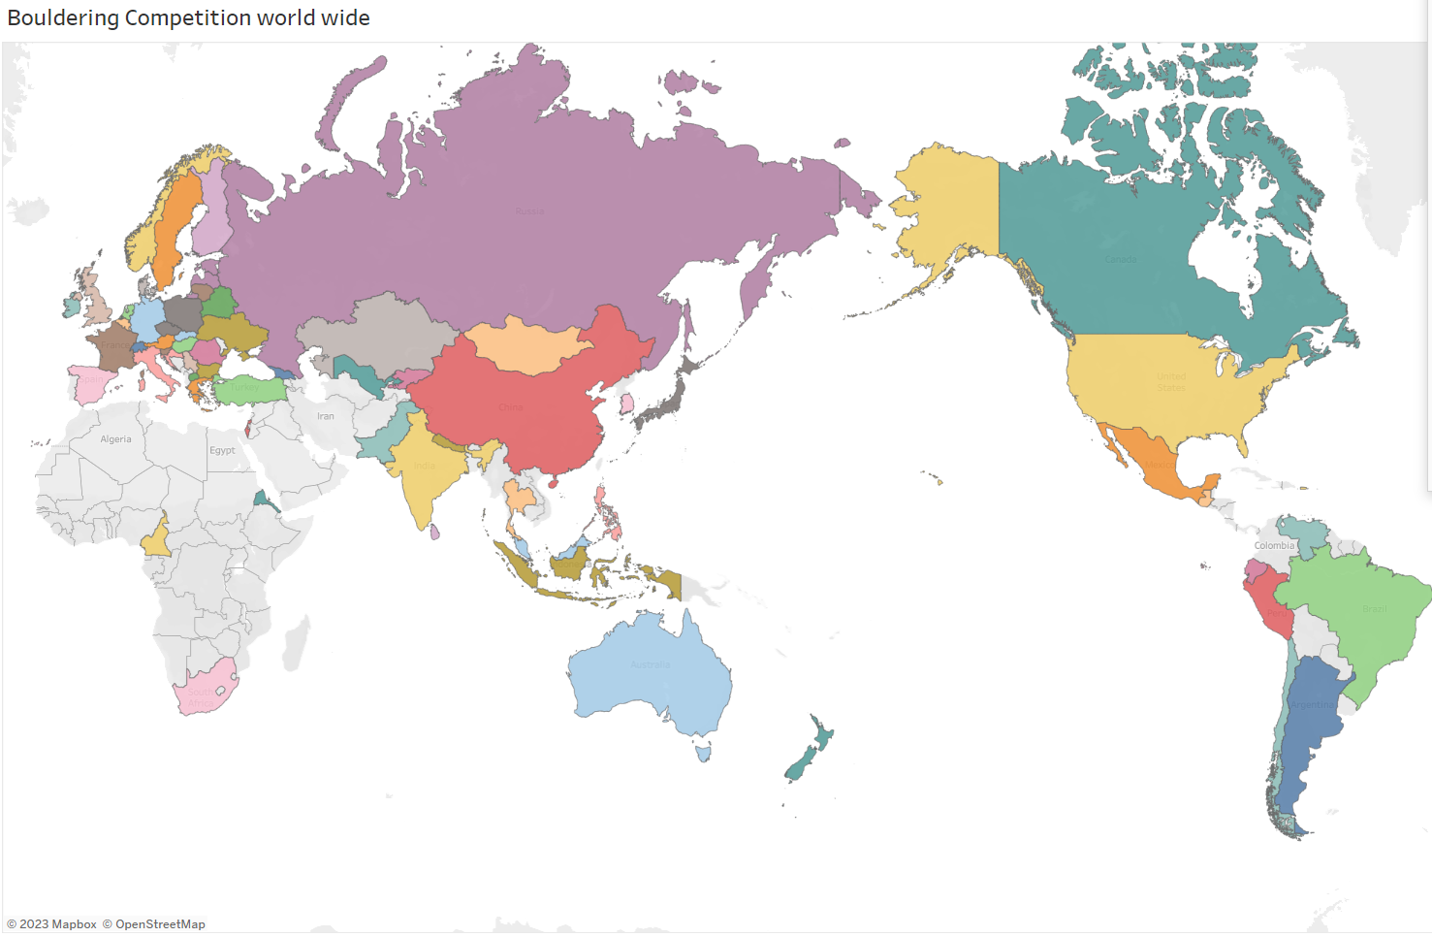
Competition Titles and Nations Across The Globe
Asia Cup (B) - Hong Kong (HKG) 2018
Asia Cup (B,S) - Bangkok (THA) 2018
Asian Championships - Kurayoshi (JPN) 2018
Asian Cup (B) - Hong Kong (HKG) 2019
Asian Youth Championships - Chongqing (CHN) 2018
European Championship (B) - Zakopane (POL) 2019
European Youth Championships (B) - Brixen (ITA) 2019
European Youth Championships (B) - Brussels (BEL) 2018
European Youth Cup (B) - Delft (NED) 2018
European Youth Cup (B) - Graz (AUT) 2018
European Youth Cup (B) - Graz (AUT) 2019
European Youth Cup (B) - Sofia (BUL) 2018
European Youth Cup (B) - Sofia (BUL) 2019
European Youth Cup (B) - Soure (POR) 2018
European Youth Cup (B) - Soure (POR) 2019
IFSC Climbing World Championships - Hachioji (JPN) 2019
IFSC Climbing World Championships - Innsbruck (AUT) 2018
IFSC Climbing Worldcup (B) - Hachioji (JPN) 2018
IFSC Climbing Worldcup (B) - Meiringen (SUI) 2018
IFSC Climbing Worldcup (B) - Meiringen (SUI) 2019
IFSC Climbing Worldcup (B) - Munich (GER) 2018
IFSC Climbing Worldcup (B) - Munich (GER) 2019
IFSC Climbing Worldcup (B) - Vail (USA) 2018
IFSC Climbing Worldcup (B) - Vail (USA) 2019
IFSC Climbing Worldcup (B,S) - Chongqing (CHN) 2018
IFSC Climbing Worldcup (B,S) - Chongqing (CHN) 2019
IFSC Climbing Worldcup (B,S) - Moscow (RUS) 2018
IFSC Climbing Worldcup (B,S) - Moscow (RUS) 2019
IFSC Climbing Worldcup (B,S) - Tai'an (CHN) 2018
IFSC Climbing Worldcup (B,S) - Wujiang (CHN) 2019
IFSC PanAmerican Championship (L, S, B, C) - Guayaquil (ECU) 2018
IFSC Youth World Championships - Arco (ITA) 2019
IFSC Youth World Championships - Moscow (RUS) 2018
Visualisation Created in Tableau
Notes:
Chu - “We used tableau to create a map to indicate all the various nations that were competing and have listed the 19 different competitions throughout. As this is an up and coming recognized sport there aren’t many competitions, however we hope to see it flourish with more competitions and more data to add to our database in the future.”

Slide 8







Technologies, Languages and Tools
ML Model 1: DNN
ML Model 2: Random Trees
Notes:
David - Aditi

Slide 9
Predictions & Results

Slide 10
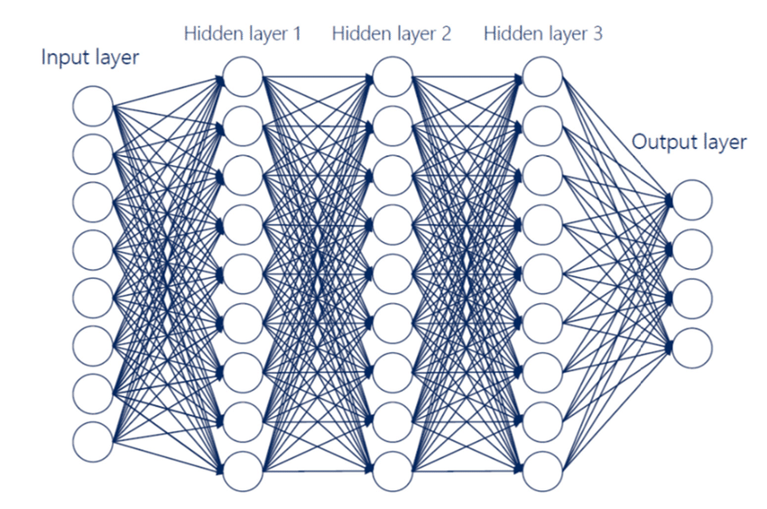
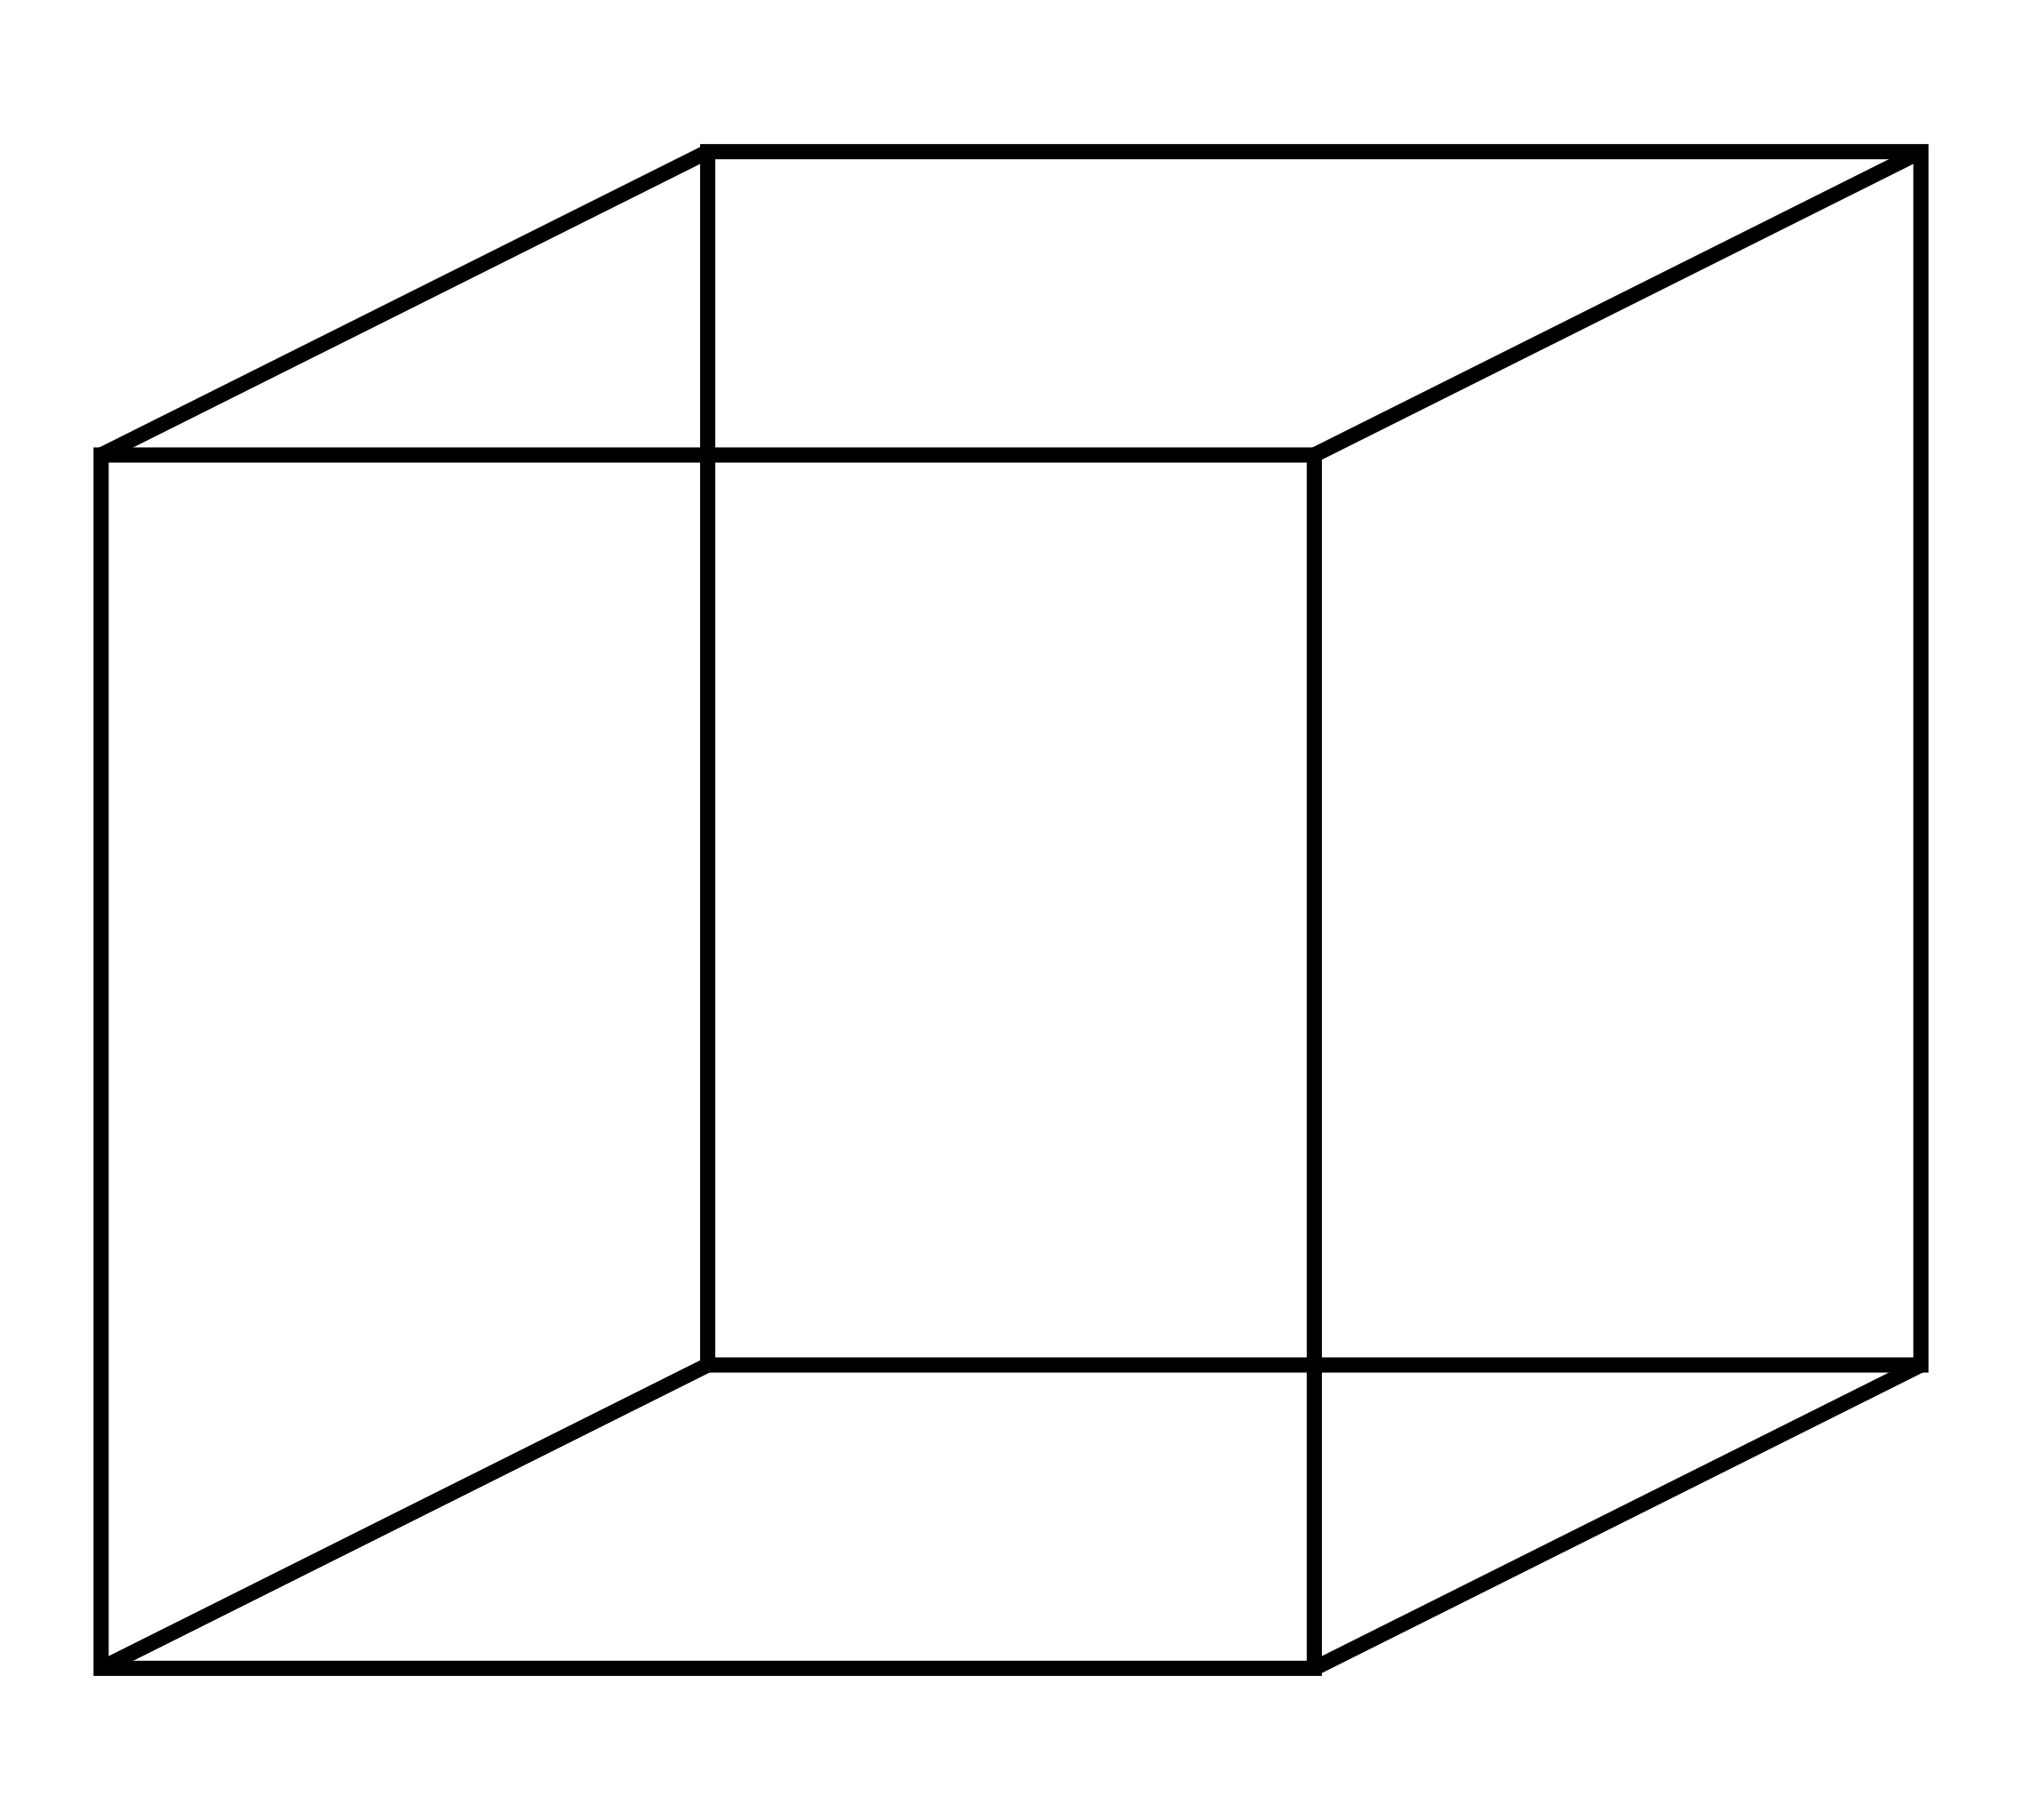
Results of the Model - Deep Neural Network
Notes:
Inputs
First lets investigate our Deep neural network
inputs.
Our original neural network had 1217 features ranging from dates to countries that were all encoded. This basic model though complex had very low accuracy ~70% as many of the features were poor at predicting finalist. The number of features was reduced as many of the features were unnecessary categorical information such as the day of competition which did not provide value, doing this we reduced the total features to 85. Including but not limited to the starting number, nations, and the athletes qualification scores.
Outputs the output of the model was the the statistical likelihood of the reaching the final displayed as either a 1 or 0.
However, this model was eventually abandoned due to the nature of Deep Neural Networks as we were unable to determine the importance of each features due to the blackbox nature of this type of modelling. Furthermore, the accuracy of the model was very comparable to our random trees model that Aditi will take to you about next.

Slide 11
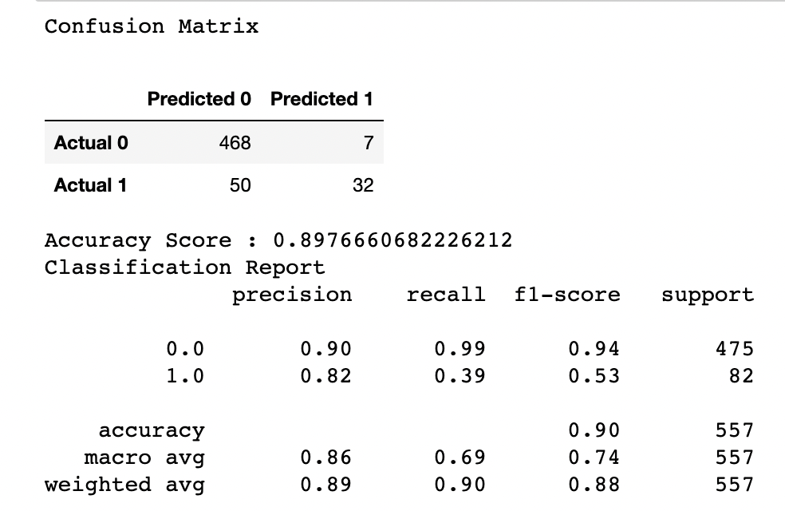
Results of the Model - Random Forest
Output of Model:
Matrix with predicted ratings for players
Accuracy of the Model:
Average RMSE of 0.897666

Slide 12
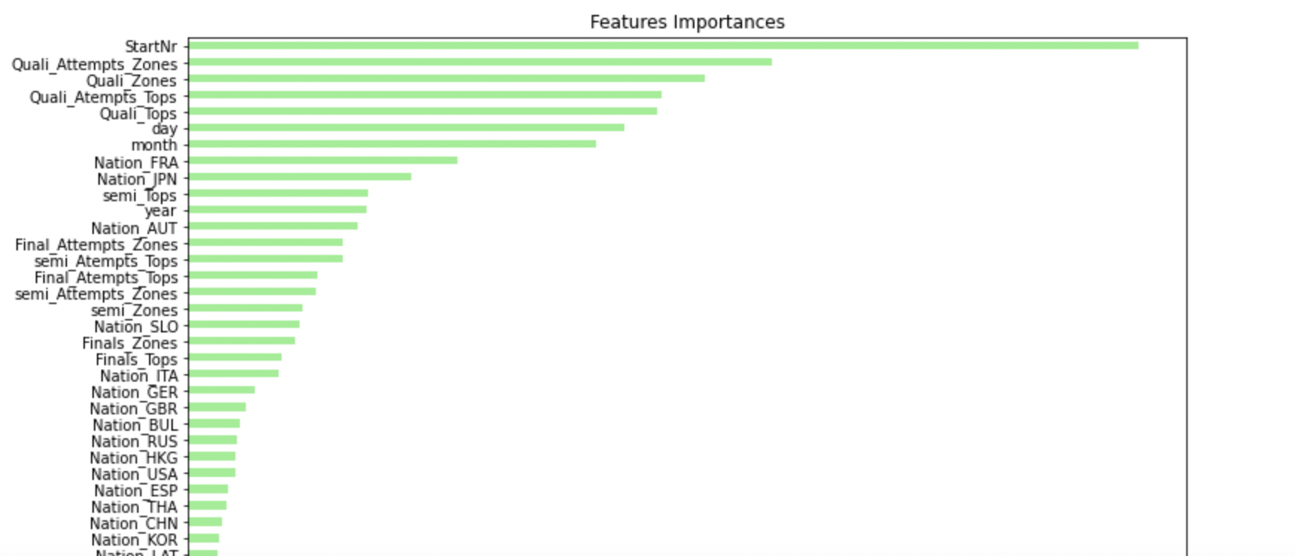
Results of the Model - Random Forest . . . . 2

Slide 13
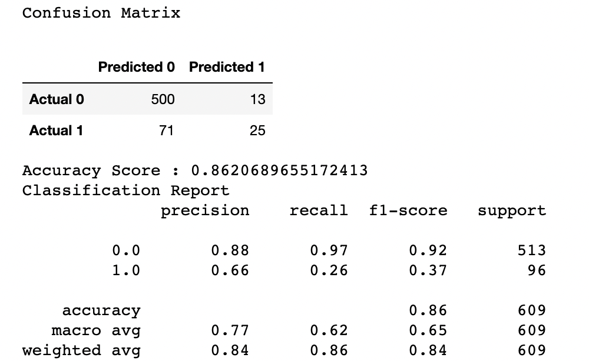
Optimization of the Model
Output of Model:
Matrix with predicted ratings for player
Accuracy of the Model:
Average RMSE of 0.86206

Slide 14
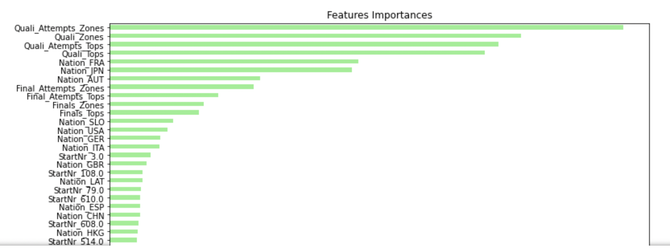
Optimization of the Model . . . . 2

Slide 15
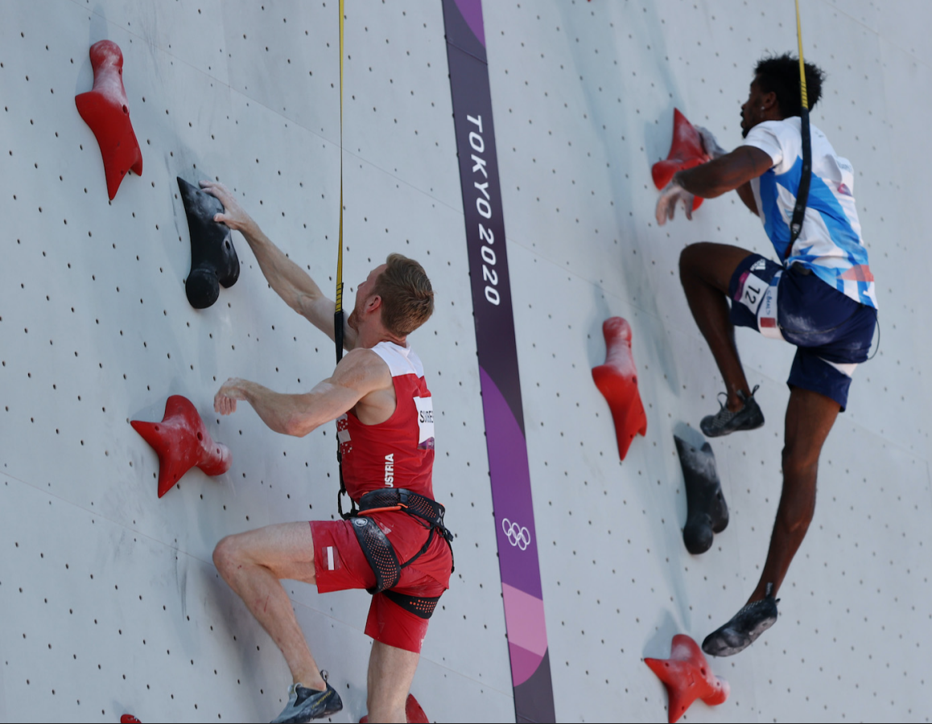
Limitations & Challenges related to the project
Database: Dataset does not contain additional information related to individual player.
Machine Learning: Some of features that the model tends to consider as high on importance do not appeal on a logical/realistic level:
An attempt to eliminate these features leads to lower accuracy, which we accept as a limitation of the model, given we still get an accuracy of greater than 85% which is considered appropriate for real life scenarios.
Notes:
As mentioned before, the dataset we used for our study does limits the level of complexity our machine models can run and we would preferably like to have some information regarding user demographics.
Both our hardware and software had difficulty working with the huge dataset we used for our machine learning models. We were able to tackle this limitation by aggregating our data into smaller chunks and perform a parallel process when running our models.
The Kmeans model was unable to accurately give movie recommendations for the users we analyzed. The recommendations that the model tried to give as well were not consistent with previous trails we ran.

Slide 16
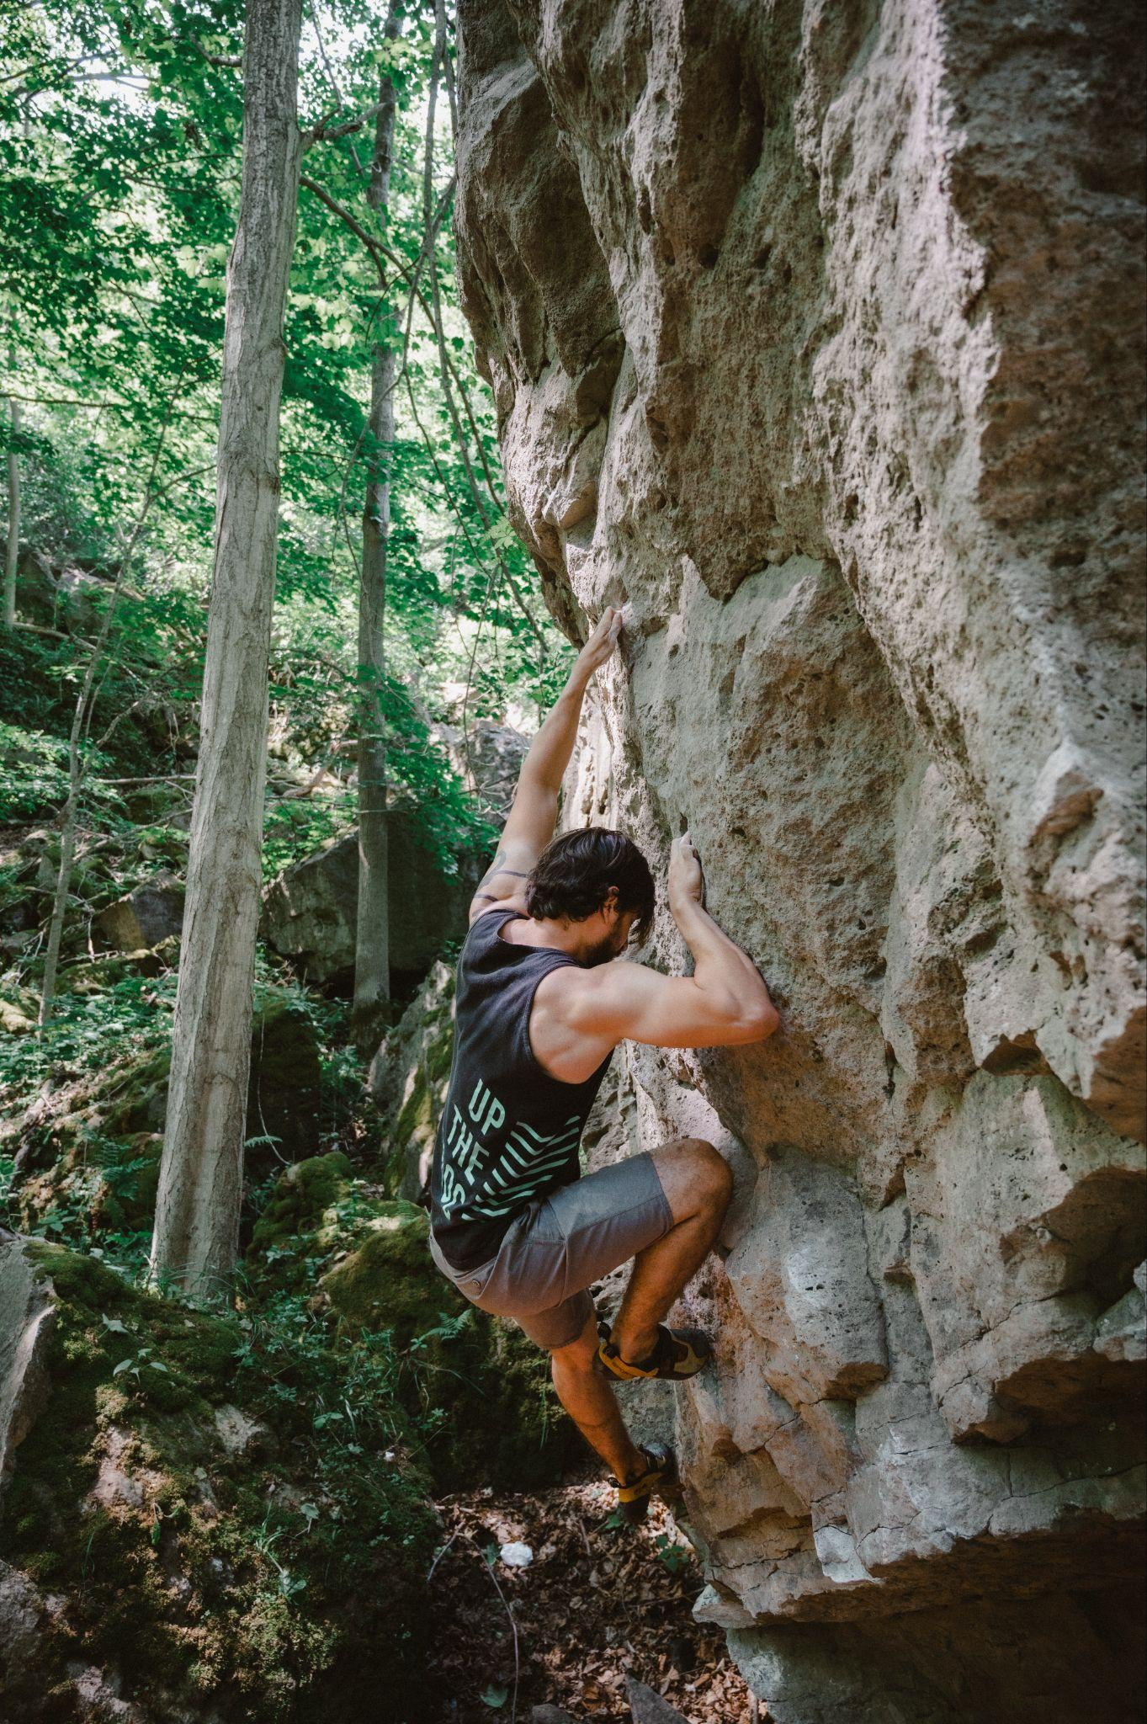
Recommendation for future analysis
Append new datasets
Individual information:
Age
Height
Weight
Reason: Allows analysis to account for individuals information, and adds another layer of complexity to the machine learning models.

Slide 17
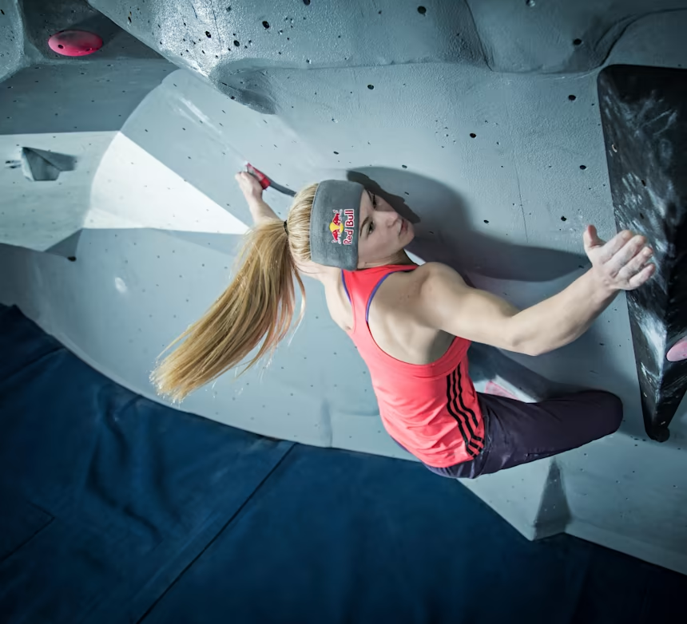


Conclusions
Notes:
We recommend that our stakeholders use our random trees model to help determine brand ambassadors, further they may want to use the features of importance graphics from the analysis to determine specific areas of interest and investigate them further. For example, while selecting brand ambassadors for the company it could be important to look for athletes coming from France and Japan as these two of the countries contribute the most statistically to our model. Athletes coming from these regions will therefore have increase likelihood to get to the finial and improve the visibility of the brand.
As the sport continues to grow in the coming year with its second showing at the summer Olympics this give our stakeholder an advantage in picking brand ambassadors. We look forward to continue improving our ability to determining potential winner and finalist as we continue to improve and working these models in the future.
Thank you!

